Slide 1
Professional Development Day (PDD) Social & Business Networking the Daily Scrum Way
Agile is more than writing user stories and burndown charts. It is about building networks between people and having a little fun along the way.
www.GregMester.com

Slide 2
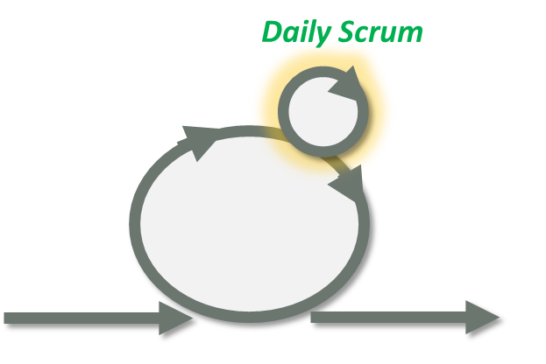
Fun Daily Scrum Networking and ICE-BREAKER
Goals:
A great tool to get teams to realize how easy it is to hold a daily scrum and it is applied here as a social networking ice breaker.
People will make personal connections and create social and professional connections throughout the conference.
Traditional Daily Scrum Questions:
What did you get “Done” yesterday?
What do you “Plan” to do today?
Are there any Blockers to you achieving your Plan?
I typically ask that teammates mention any time off that might impact transitions of work, like kids doctor’s appointment or just taking the afternoon off
Daily Scrum can get boring
I coach my Scrum Masters to change it up at times
Also this exercise is a great way to get teams into that personal connection or network
Make sure the Teams do not become Robots ☺
www.GregMester.com

Slide 3
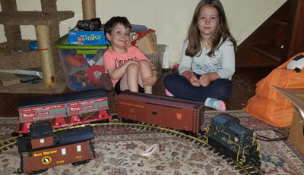
Part A: What fun thing did you do last weekend?
Topic: Fun Daily Scrum Networking and ICE-BREAKER
Logistics: Form groups of less than 30 people
Introduction: Introduce yourself
Questions:
What fun thing did you do last weekend?
What fun thing do you plan to do this coming weekend?
What blockers do you have to having fun this weekend?
After you are Finished pass the ball to the next person
This exercise is supposed to:
Get people to know each other
Have some fun
Prove that Daily Scrum should not take long
Teams of 30 people take less than 10min
Spend the Remaining time in the exercise and day making connections
www.GregMester.com

Slide 4
Part B: What is Next for Your IIBA Agile Journey?
Topic: Fun Daily Scrum Networking and ICE-BREAKER / Business Connection
Logistics: Form groups of less than 30 people
Introduction: Introduce yourself
Questions:
What new Agile technique/concept did you do last week or month?
What new Agile technique/concept would you like to learn today?
What blockers do you have to trying a new agile concept and could you use some help of follow-up with IIBA?
After you are Finished pass the ball to the next person
This exercise is supposed to:
Get people to think about their Agile Journey
Make some Business Connections
Share your Learning Goals
Teams of 30 people take less than 10min
Spend the Remaining time in the exercise and day making connections
Daily Scrum
www.GregMester.com

Slide 5
Applying This Back in the Office
Additional twists to this exercise for Agile Coaches and Scrum Masters
As the lead instructor walk around the room so the people learn not to talk to scrum master but each other
As the lead instructor work your way out of the room and allow the class
Get the students/team to pick the next person
Make sure you record how long it takes the team or class to go through the exercise. Then ask the people for estimates as to how long they think it took for everyone to speak
The additional learning for the Team:
That a self directed work team can handle the daily scrum without the scrum master
They learn not to talk to the Scrum Master, but Each Other
They learn their estimate of time will probably be incorrect
www.GregMester.com

Slide 6
Thank You and Happy Scrumming
Contact Information:
Would you like an Agile Mentor?
Agile Training
Find out what other Agile Groups are in the Philadelphia area
www.GregMester.com
Email: greg.mester@gregmester.com
Twitter: @gemphilly
Twitter List to follow Agilist around the country
http://www.gregmester.com/twitter-agilist/
https://twitter.com/gemphilly/lists/agilists

