Slide 1

Professional Development Day (PDD)
Agile Story Telling
Requirements Refinement
Getting Stories Ready for the Development (Cross-functional Dev & Test) Teams
Looking at XP, Scrum, Kanban or Lean
www.GregMester.com

Slide 2
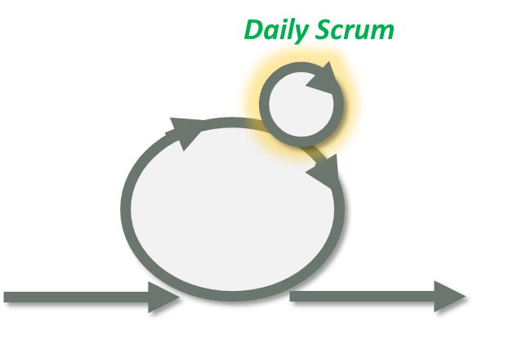
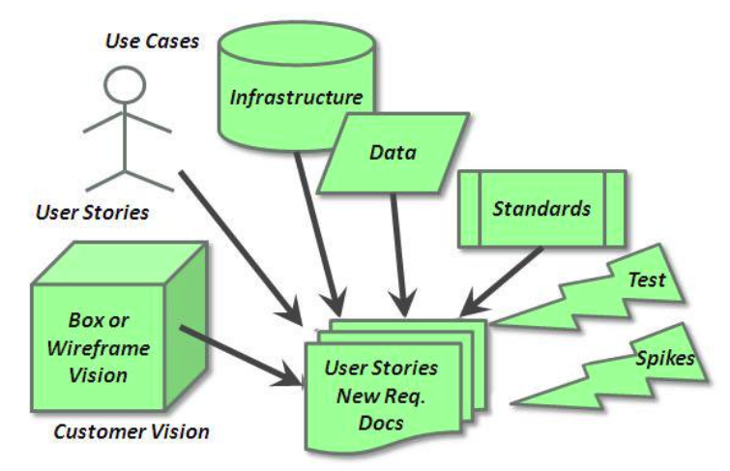
Agenda
Agile Story Telling
  Gathering Requirements
    Information Circles
    Change
  Right Sizing of Stories
    Value / Prioritize
    Feature Decomposition
    Time Box Consideration
  Refinement of Stories
    Refinement Flow
    Work Flow
    Health of the Backlog
  Agile Extras
Appendix:
  Different Agile Environments
    XP, Scrum, Kanban, Lean
www.GregMester.com

Slide 3
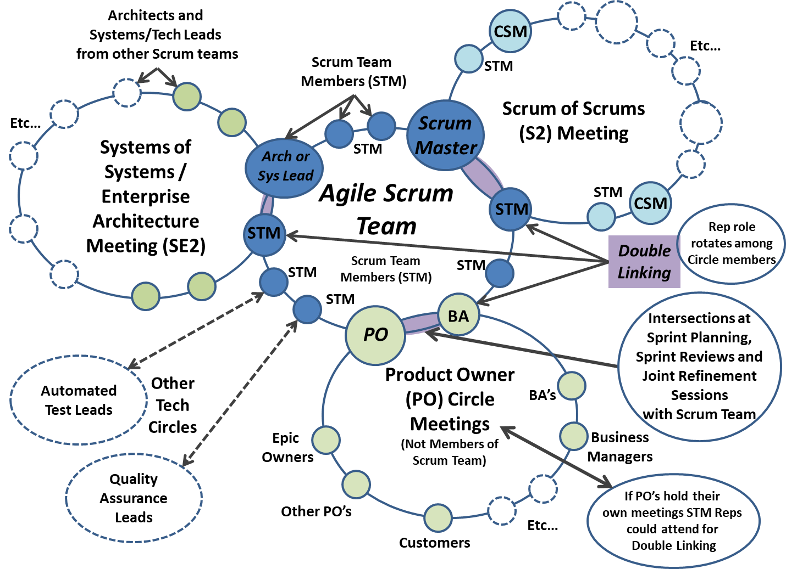
Gathering Requirements: Information Circles

Slide 4
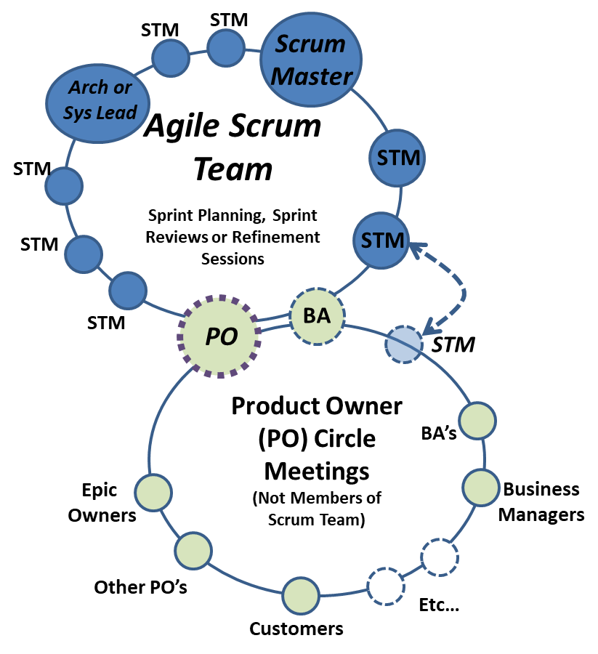
Information Circles – Building the Backlog
Attending Demonstrations
Information Gathering Sessions
Product Owner / Business Meetings / Customer Meetings
  Don’t let the PO go without the BA
  Risk Information Lost
Vision Meetings
Proof of Concepts or Spike Demonstrations

Slide 5
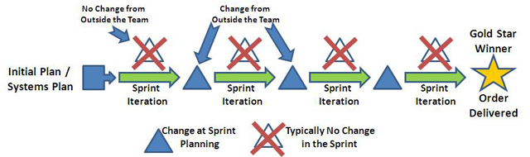
Rate of Change
Myth: Agile Development = Requirements Change at Any Time 24×7
Truth: Requirements Don’t Change While Developing
Scrum Change: Time Box Based, Change at Beginning of Each Sprint
Kanban Change: To Do WIP Limit Based – Add new Story/Requirement when one is Pulled from “To Do” to
“In Process”

Slide 6
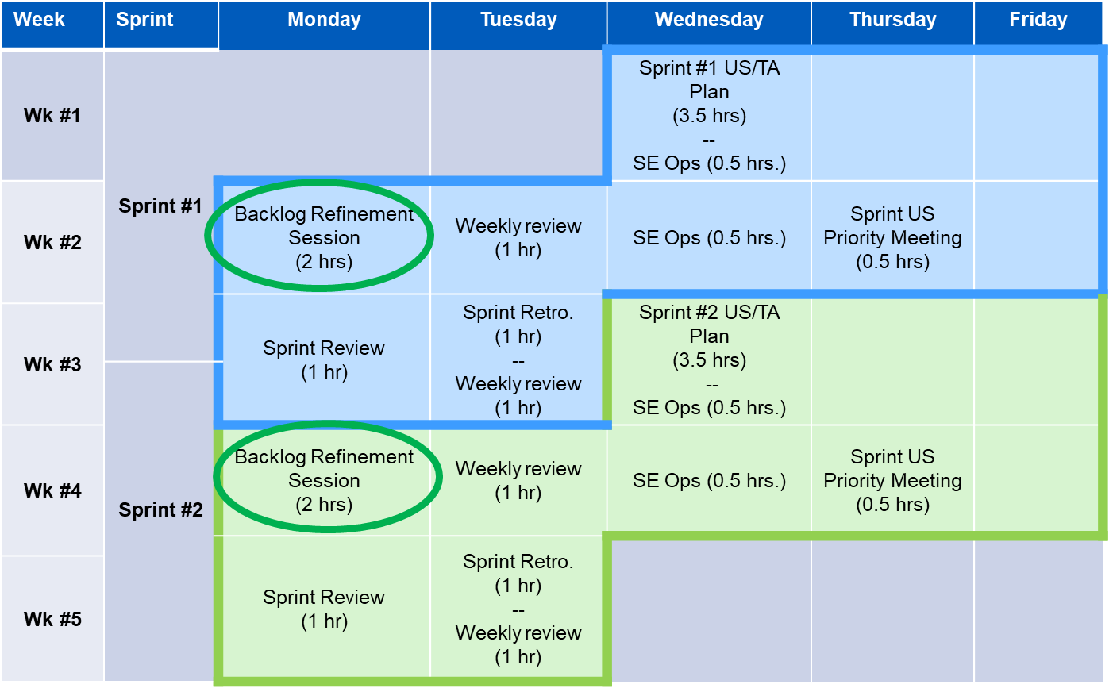
Scrum Sprint Calendars

Slide 7
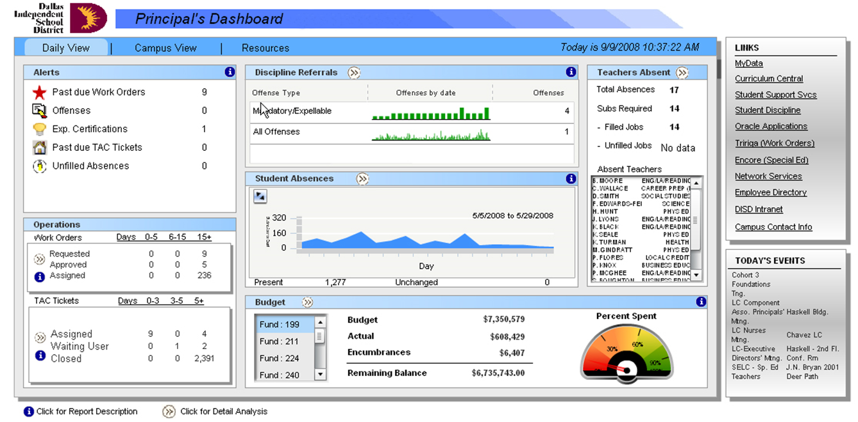
Vision & Value
Brand
User Profiles
Goals
Site Audit
User Needs
Create User Stories
Site Map
Wireframes
Awareness
Engagement
Retention / Return
Referral
Revenue

Slide 8
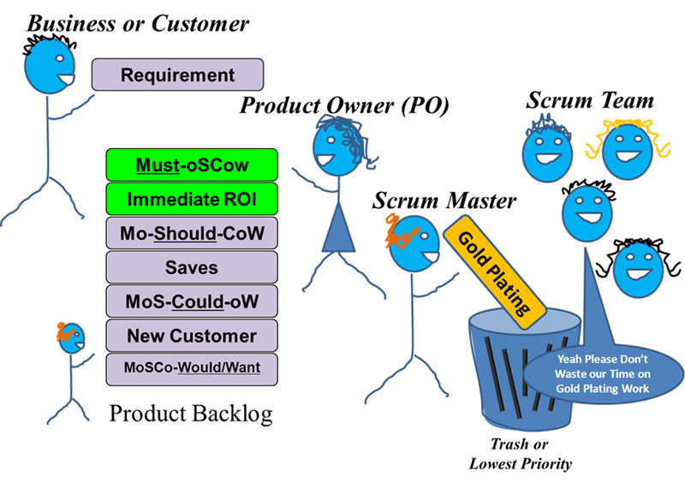
Prioritize MoSCoW
MoSCoW and ROI with the following prioritized order:
  Customer MUST Have (The “M” in MoSCoW)
  Brings in Immediate CASH INCOME – ROI
  Customer SHOULD Have (The “S” in MoSCoW)
  Saves the Company Money – ROI
  Customer COULD Have
  New Customer – Future ROI
  Won’t Have (Would like)
  Gold Plating – Only after the
  company pays bonuses
  and donates to charity

Slide 9
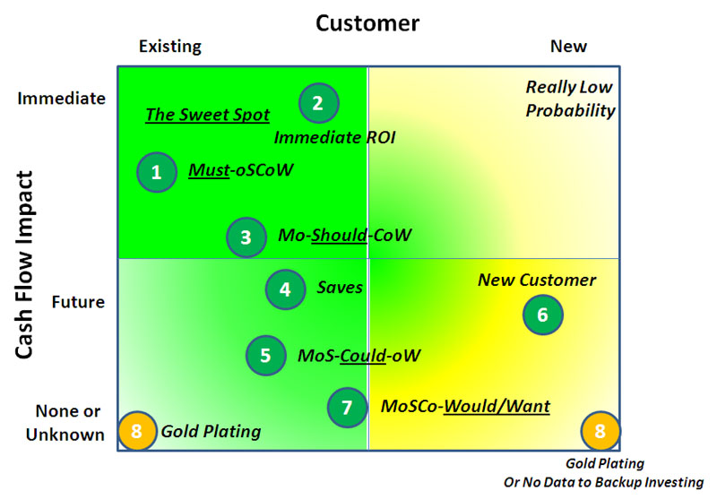
Prioritize – Cash Flow & Customer

Slide 10
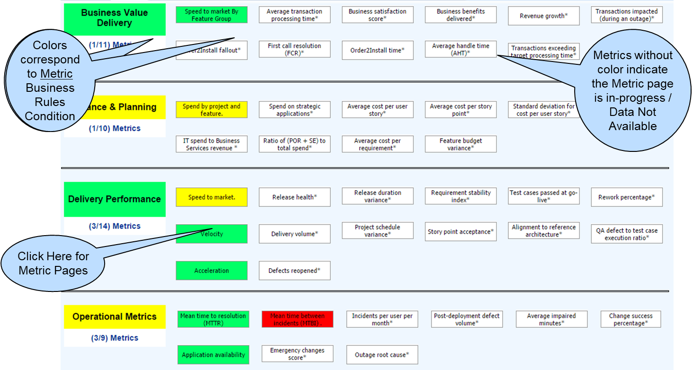
Vision (Prioritizing Features and Build Pieces)

Slide 11
Feature and Story Decomposition
Feature Characteristics
  Very Large Story
  Typically Lots of “And’s” in the description
  Can bridge more than one Sprint
  Made up of more than one Story/Requirement
  Integration Testing
Story Characteristics
  Small Size (INVEST)
  Very Few if any “And’s” in the descriptions
  Complete in one Sprint
  Ideally Complete in a day or two
    Includes Dev & Testing
  Take into account Automation Testing
 | Sprint 1 | Sprint 2 | Sprint 3 | Sprint 4
Feature 1
Feature 2
Feature 3
Feature 4
Feature 5
Velocity | 3 | 3 | 3 | 3
R
R
R
R
R
R
R
R
R
R
R
R

Slide 12
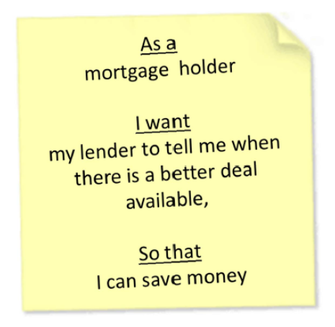
Story Writing
INVEST
  Independent
  Negotiable
  Valuable
  Estimable
  Small
  Testable
Definition of Done
  Working SW
  Unit Tests
  Code review
  Installer
  Tests
  Functional Tests
  Successful Demo to Customer (Product Owner)
  Regression Tests
  Documentation

Slide 13
Exercise – 6 Word Stories (5 minutes optional)
There are 6 elements to Business Stories
  State who the Story is about
  Describe what is being done
  Timeframe, when of the story
  Define Why the Actions are Occurring
  Explain how the actions in the story is being taken
  Provide Verifiable quantitative evidence of assertion & performance
Attempt to write a 6 word Title to Describe your Story
  Example:
    As an trouble shooter (TS), I want to move a Email from Triage to the next flow process as New, Bug, Enhancement or Reject within 10 minutes to ensure submission email is properly worked in a timely manner.
    As an TS, I want to our Triage Email to the next flow process as New, Bug, Enhancement or Reject within 10 minutes to ensure email is properly worked in a timely manner.
    TS Triage Email to next stage after review (10 Mins)
Step 1: 1 minute
Step 2: 1 minute
From lecture and class with:
Thomas Cagley - Storytelling
Step 3: 1 minute

Slide 14
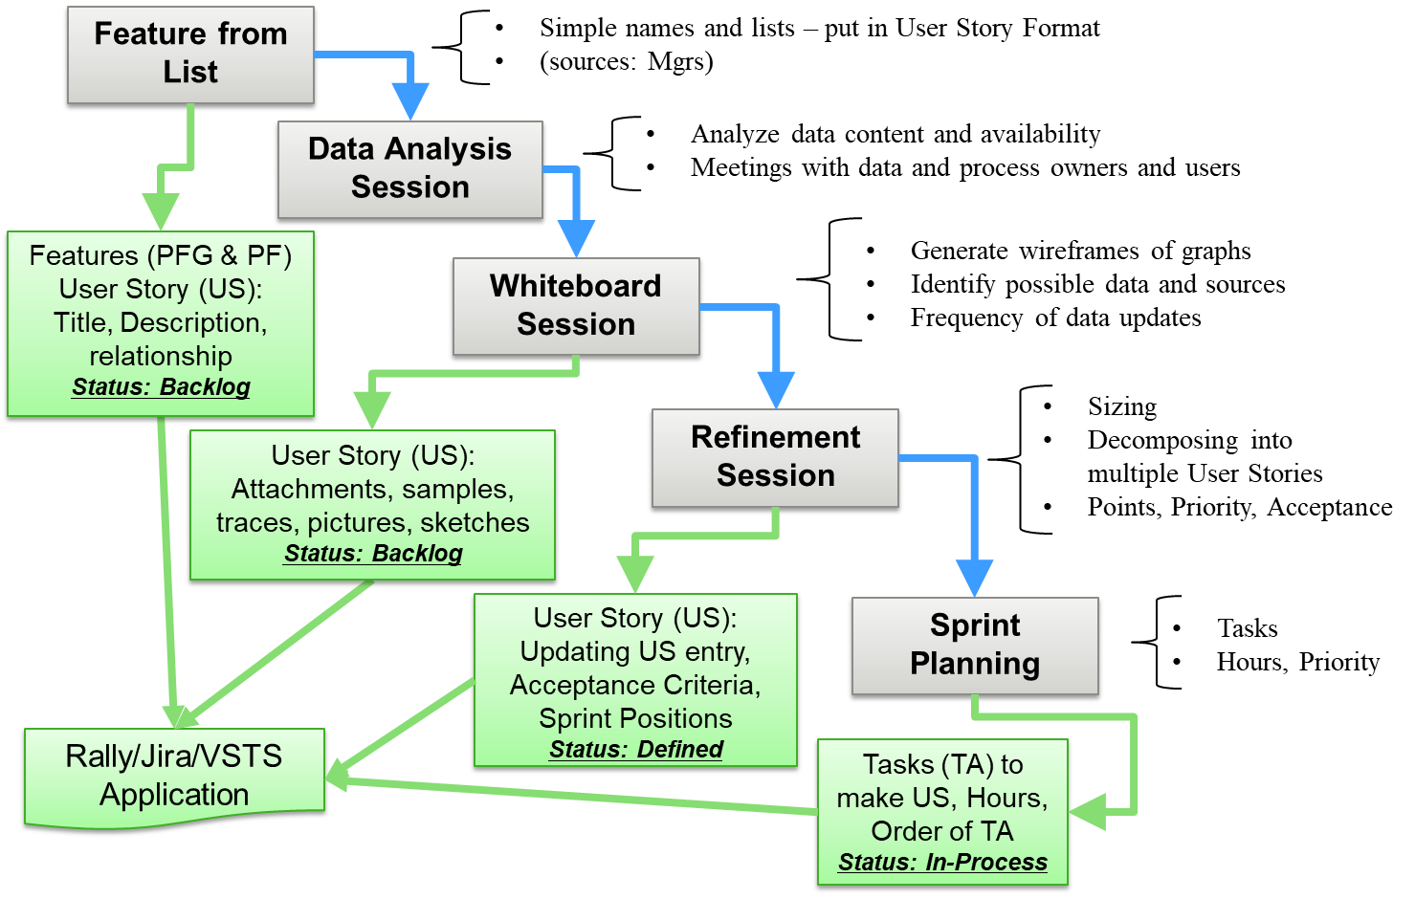
Story Refinement Flow

Slide 15
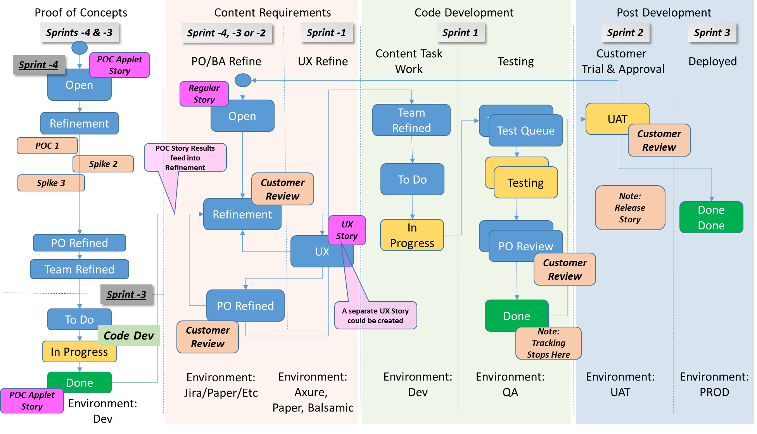
Measuring Story Refinement
Flow (Proof of Concepts, Spikes & UX Proofs)

Slide 16
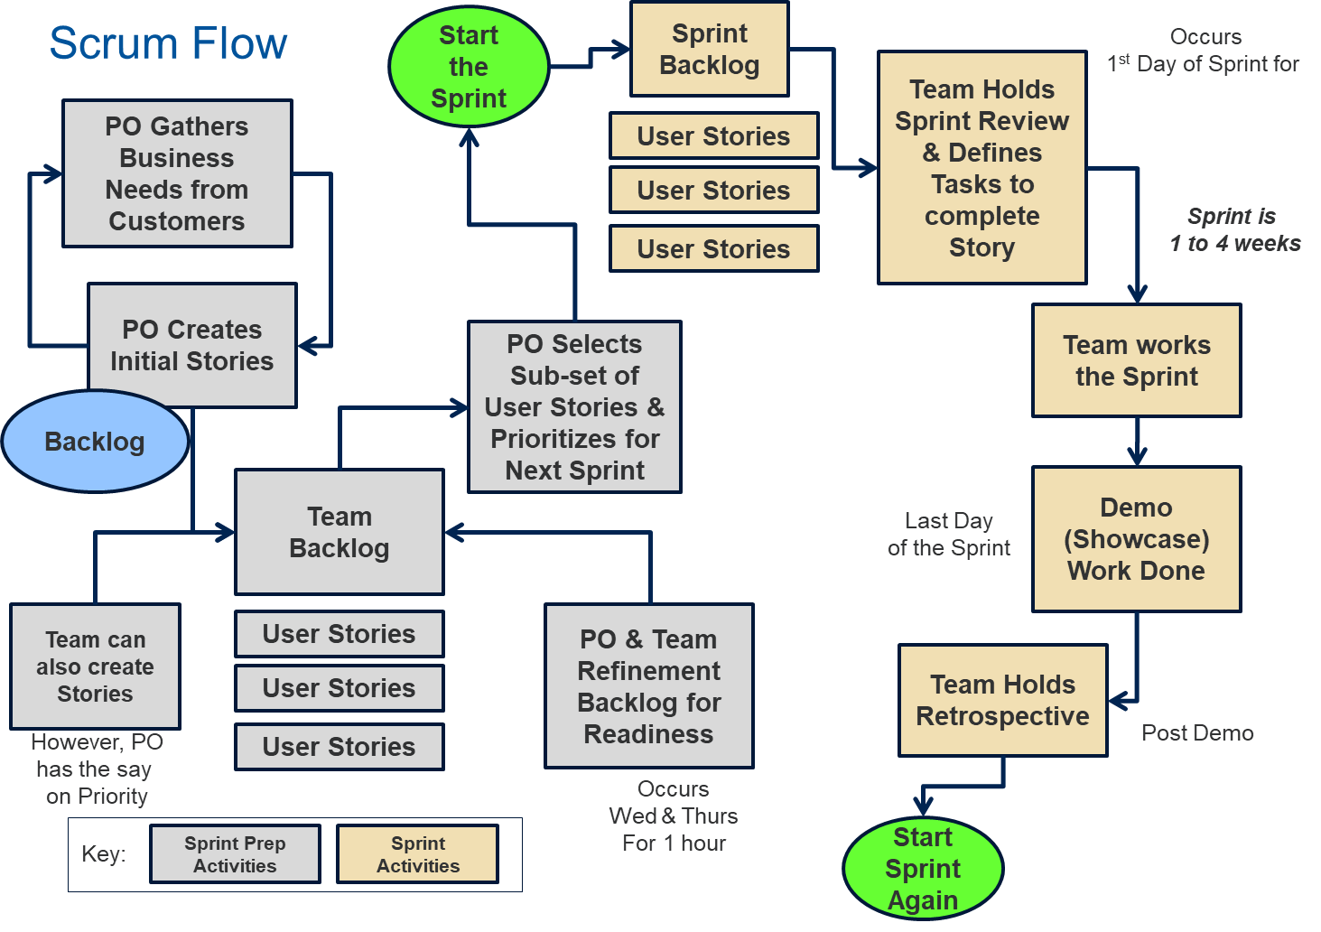
Scrum Flow

Slide 17
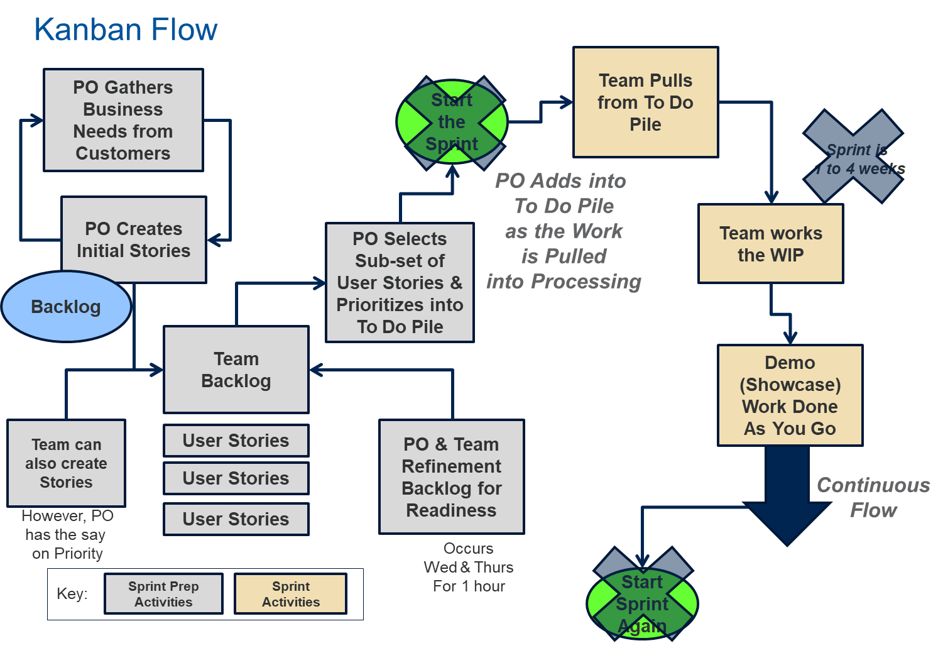
Kanban Flow

Slide 18
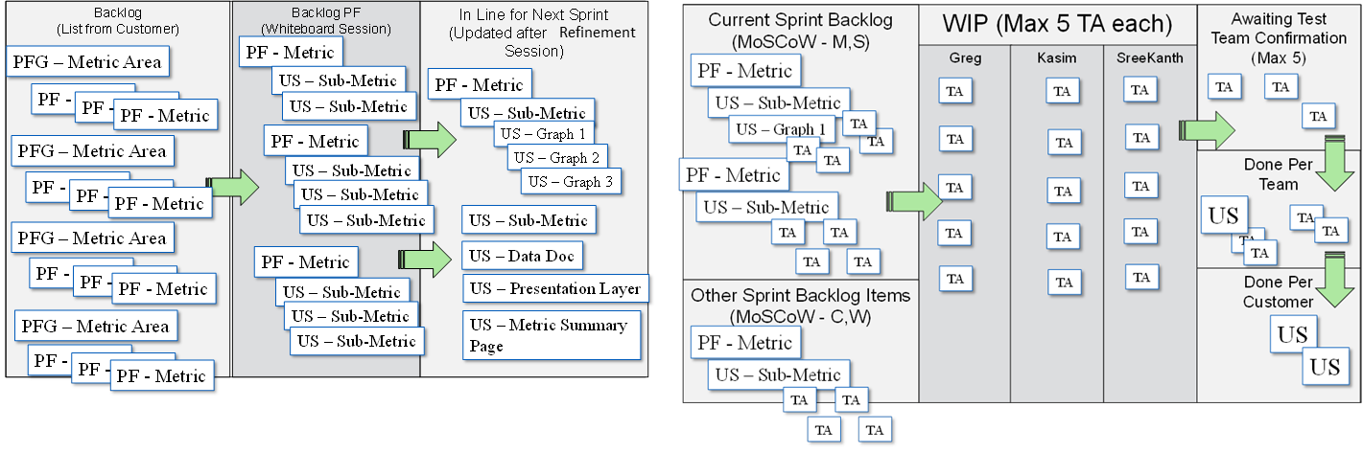
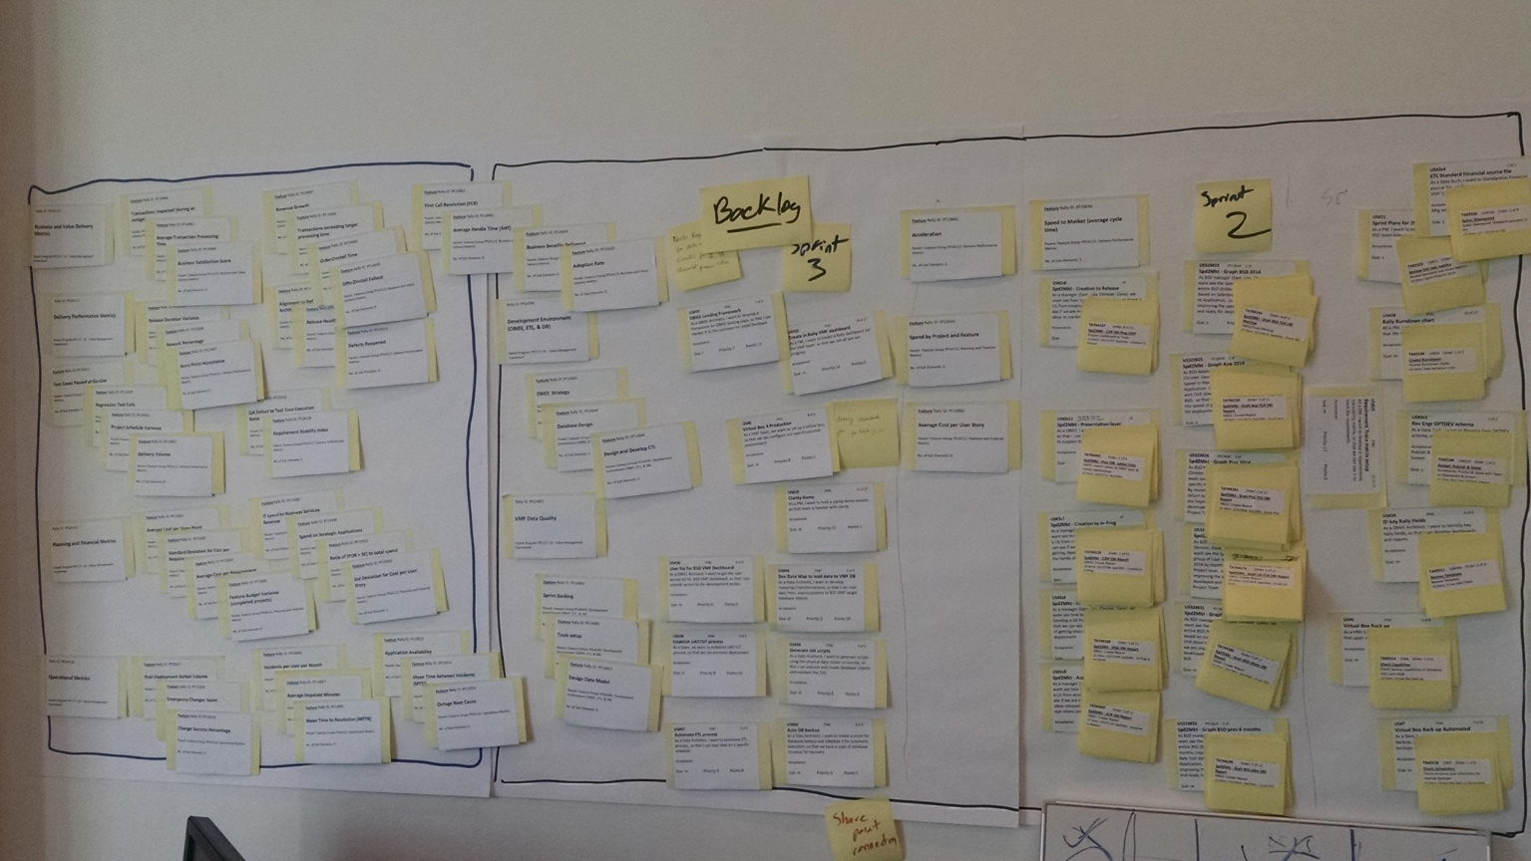
Backlog Refinement

Slide 19

Measuring Story Refinement
Health of Backlog (Simple Pie Charts)
Current Sprint
Sprint +1
Sprint +2
Development Team
Task
Concentration
PO / BSA
Story
Concentration
PO
Feature
Concentration

Slide 20
Measuring Story Refinement
Health of Backlog (Cumulative Flow)
Current Sprint
Development Team
Task
Concentration
Sprint +1
Sprint +2
Open/New
Refining
PO
Feature
Concentration
PO / BSA
Story
Concentration
PO Refined
Ready 2 Plan
To Do

Slide 21
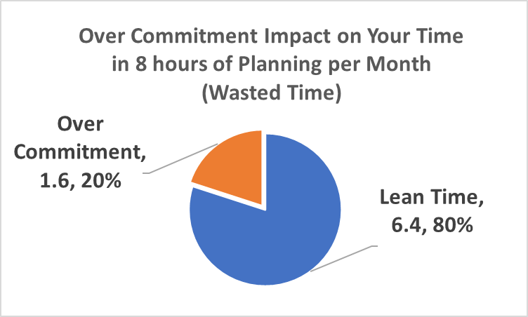
Agile Extras
Mixing it all
  3 Amigos (quasi XP) – Used in Scrum & Kanban
    Where PO/BA, Dev and Tester get together at the beginning of Sprint or Before picking the Story from the To Do pile
    The three work together to determine Acceptance Criteria
    PO/BA answers questions from Dev & Tester
    Maybe Code in Cucumber and even a little TDD
  Lean (Refinement)
    Only Refine a Sprint or Two of Stories
    Any more is a waste of time and not
    Lean Thinking
    Over Committing is Not Lean Thinking
    (Watch Velocity)
    Don’t waste time Refining
    Stories that are not going to
    get “Done” in Next Sprints
    – What if the Priority Changes?
      20% Over-Commit is 30min to 2 hours of
      wasted time per Sprint x Number of people on the Team

Slide 22
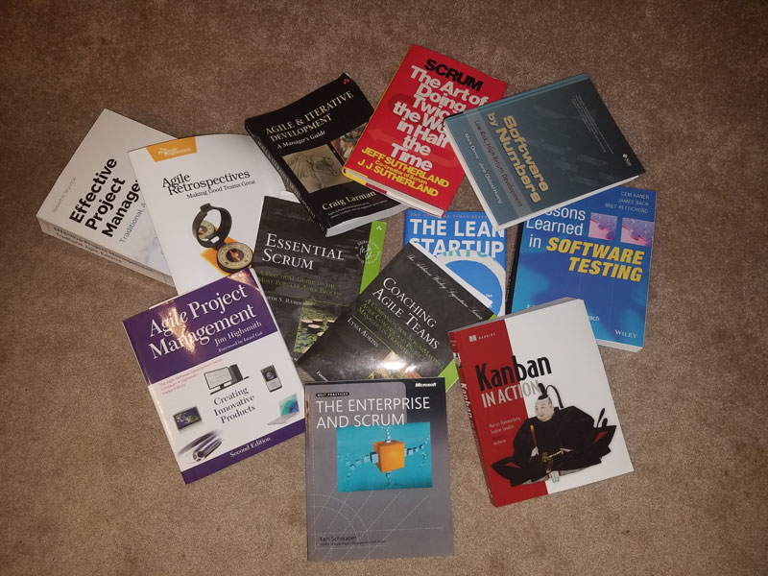
Closing: Reference Materials

Slide 23

Thank You and
Happy Scrumming
Contact Information:
  Would you like an Agile Mentor?
  Agile Training
  Find out what other Agile Groups are in the Philadelphia area
  www.GregMester.com
  Email: greg.mester@gregmester.com
  Twitter: @gemphilly
  Twitter List to follow Agilist around the country
    http://www.gregmester.com/twitter-agilist/
    https://twitter.com/gemphilly/lists/agilists

Slide 24
Appendix Information
The following slides are a few extra slides that briefly talk to the various Agile Methodologies

Slide 25
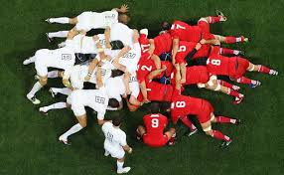
Quick Battle Summary
XP
  Everyone Working Together to Solve a Problem at The Same Time
  Pair Programming, Unit Testing, Integration Testing
Scrum
  Time Boxed
  Teaming to solve a problem, but also some me time
  Cross Trained
  Team Delivery
Kanban
  Continuous Pull System
  More Individual Approaches
  Work In Process or Progress (WIP) Limits
    Prevents too much or too little work from
    entering the system
  Quasi-Cross Trained
Lean
  Eliminating Waste
  Waste in Time – Waiting
  Maximize Value
Scrum
Kanban

Slide 26
Agile Systems or Methodologies
Agile Manifesto
  We are uncovering better ways of developing software by doing it and helping others do it.
  Through this work we have come to value:
    Individuals and interactions over processes and tools
    Working software over comprehensive documentation
    Customer collaboration over contract negotiation
    Responding to change over following a plan
Kanban
Scrum
Business Analysis
Has to Be Agile
Lean
XP

Slide 27
Extreme Programming (XP)
Dev System A
Pair
Programming
Customer
Tester
Test Driven
Development (TDD)
Mockups
Facilitator
Feature
BSA
Production Data
Sampling
Test Driven
Development (TDD)
Tester
Dev System B
Integration
Testing
Dev System B
Tester
Pair
Programming
Dev System B
Pair
Programming
Tester
Dev System C
Test Driven
Development (TDD)
Pair
Programming
“XP is a lightweight methodology for small to
medium sized teams developing software in
the face of vague or rapidly changing requirements”
--- Kent Beck

Slide 28
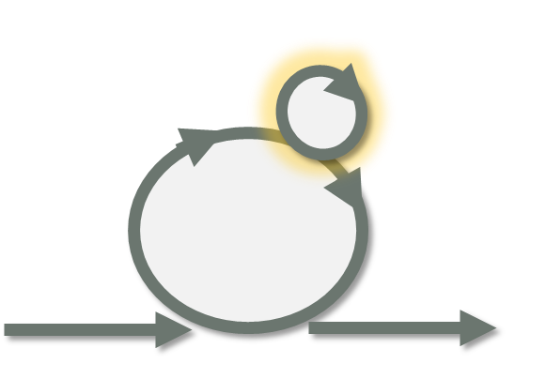
Scrum
Product Backlog
Done Pile
WIP:
Team
Velocity
Scrum Board
Time Boxed
Sprint Backlog
Dev
Each Story
Each Story
Test
Review or Demo
Release
Time-Box
Planning (Time Box and Daily)
Continuous Flow
Cross Functional As Much as Possible
Retrospective
Roles:
Product Owner
Dev Team
Scrum Master

Slide 29
Kanban
Product Backlog
Kanban Board
Done Pile
WIP 5
WIP 5
WIP 5
WIP 5
To Do
Dev
Test
Release
Each Story
Each Story
Roles
Product Owner
Dev Team
Dev & Tester
Scrum Master
No Time-Box
Planning (Time Box and Daily)
Continuous Flow
Cross Functional When WIP is Maxed out
Retrospective (optional)

Slide 30
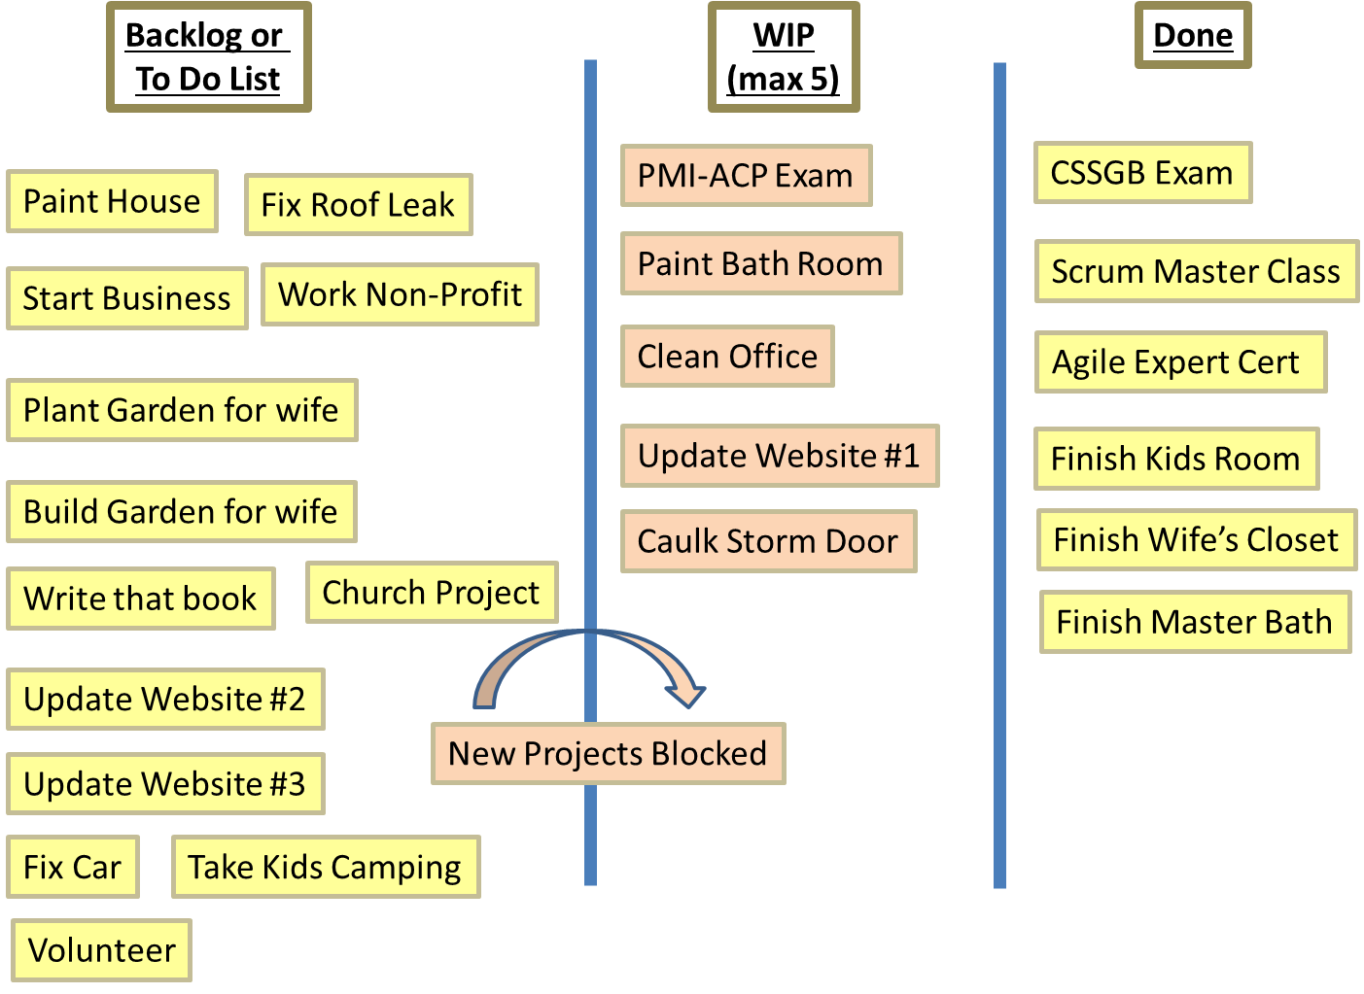
Personal Kanban Board

Slide 31
Agile Systems or Methodologies
Mixing it all
  Scrum-ban
    Combining WIP Limits into Scrum Boards and # of Tasks worked at a time
  3 Amigos (quasi XP) – Used in Scrum & Kanban
    Where PO/BA, Dev and Tester get together at the beginning of Sprint or Before picking the Story from the To Do pile
    The three work together to determine Acceptance Criteria
    PO/BA answers questions from Dev & Tester
    Maybe Code in Cucumber and even a little TDD
  Kanban
    Adding Retrospectives
      Need to get better as a Team
    Adding Time Boxes
      Just to clear Done Pile from
      the tracking systems
  Lean (Refinement)
    Only Refine a Sprint or Two of Stories
    Any more is a waste of time and not
    Lean Thinking
    Over Committing is Not Lean Thinking
    (Watch Velocity) – Don’t waste time Refining Stories that are not going to get “Done” in Next Sprints – What if the Priority Changes?
      20% Over-Commit is 30min to 2 hours of wasted time per Sprint x Number of people on the Team
Kanban
Scrum
Lean
XP

